Slide 1
Troubleshooting Storage
Module 5

Slide 2
Importance
Nearly every service depends on access to storage. When a host’s access to a certain storage device is lost, you must use your troubleshooting knowledge and skills to quickly identify the problem and restore the access.

Slide 3
You Are Here
Course Introduction
Introduction to Troubleshooting
Troubleshooting Tools
Troubleshooting Virtual Networking
Troubleshooting Storage
Troubleshooting vSphere Clusters
Troubleshooting vCenter Server and ESXi
Troubleshooting Virtual Machines

Slide 4
Module Lessons
Lesson 1: Storage Connectivity and Configuration
Lesson 2: Multipathing
Lesson 3: Virtual SAN

Slide 5
Lesson 1: Storage Connectivity and Configuration

Slide 6
Learner Objectives
By the end of this lesson, you should be able to meet the following objectives:
Discuss VMware vSphere® storage architecture
Identify possible causes of problems in various types of datastores
Analyze common storage connectivity and configuration problems and discuss possible causes
Solve storage connectivity problems, correct misconfigurations, and restore LUN visibility

Slide 7
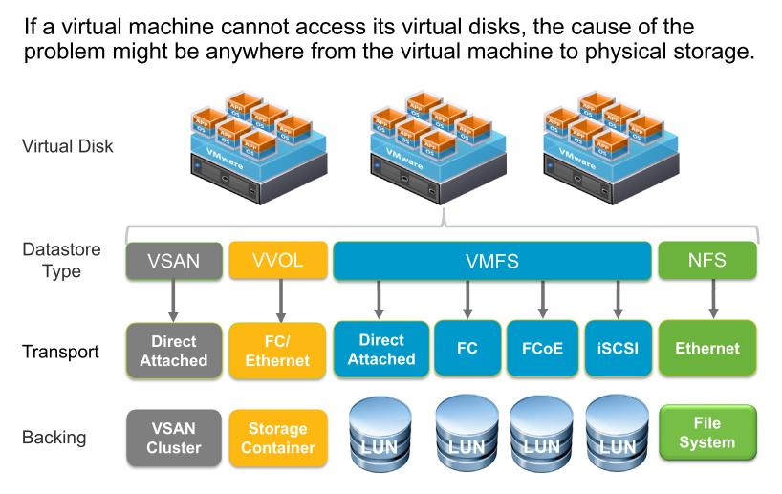
Review of vSphere Storage Architecture

Slide 8
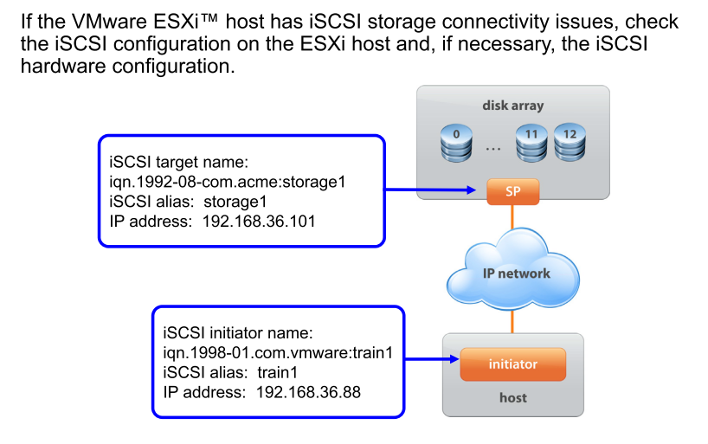
Review of iSCSI Storage

Slide 9
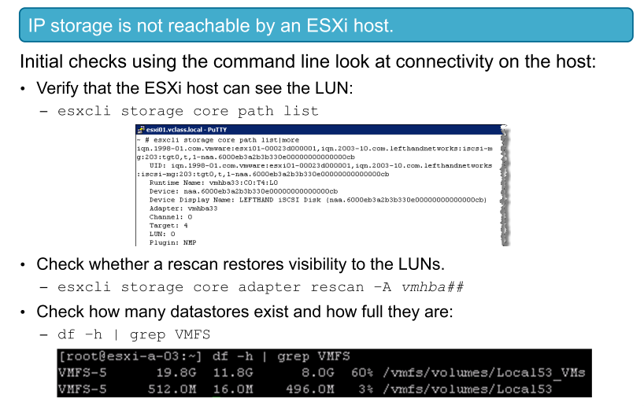
Storage Problem 1

Slide 10
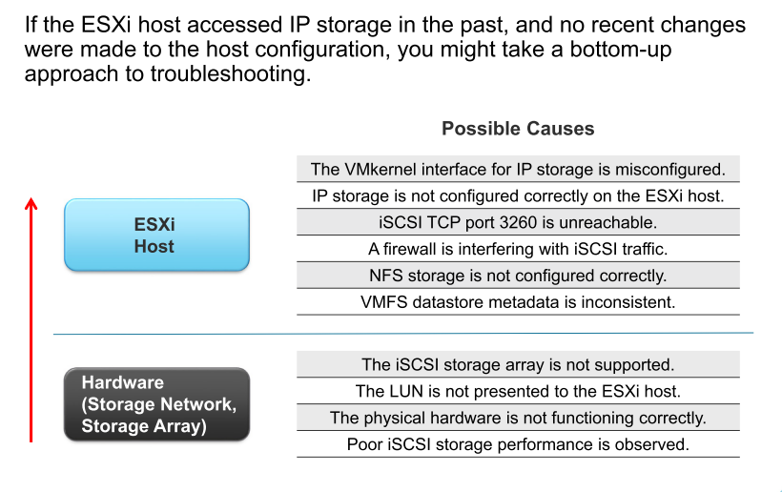
Identifying Possible Causes

Slide 11
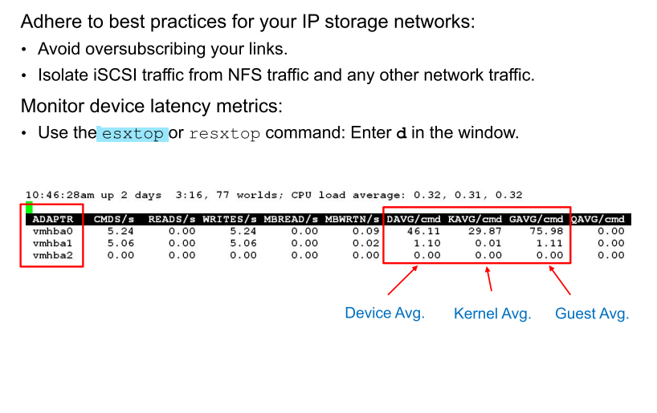
Possible Cause: Poor iSCSI Storage Performance

Slide 12
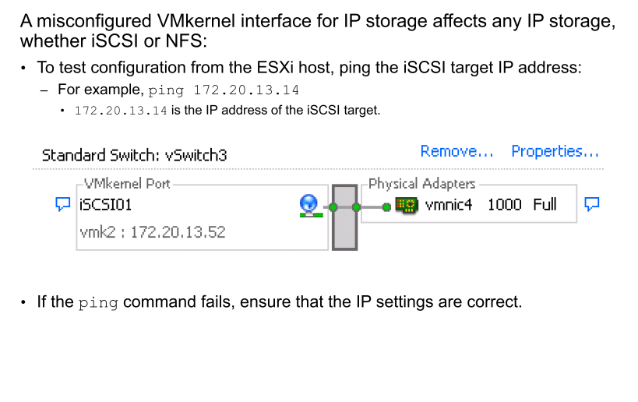
Possible Cause: VMkernel Interface Misconfiguration

Slide 13
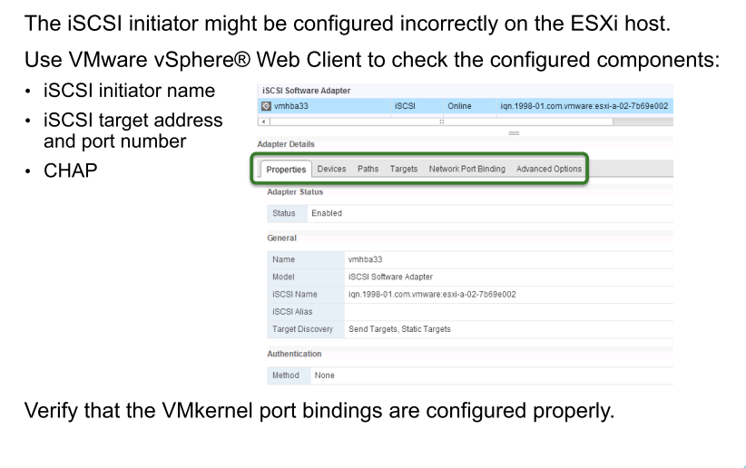
Possible Cause: iSCSI HBA Misconfiguration

Slide 14
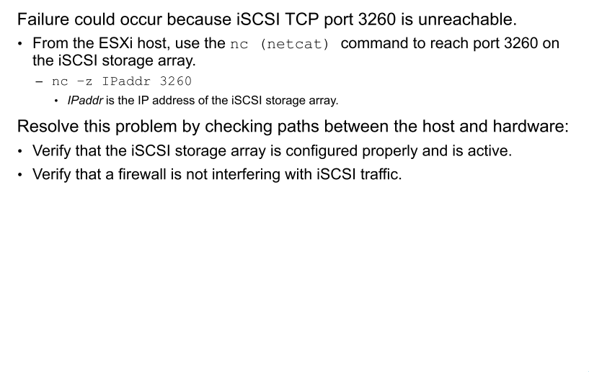
Possible Cause: Port Unreachable

Slide 15
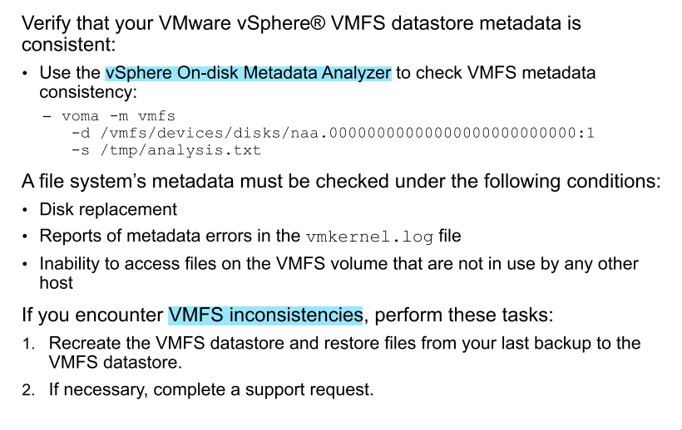
Possible Cause: VMFS Metadata Inconsistency

Slide 16
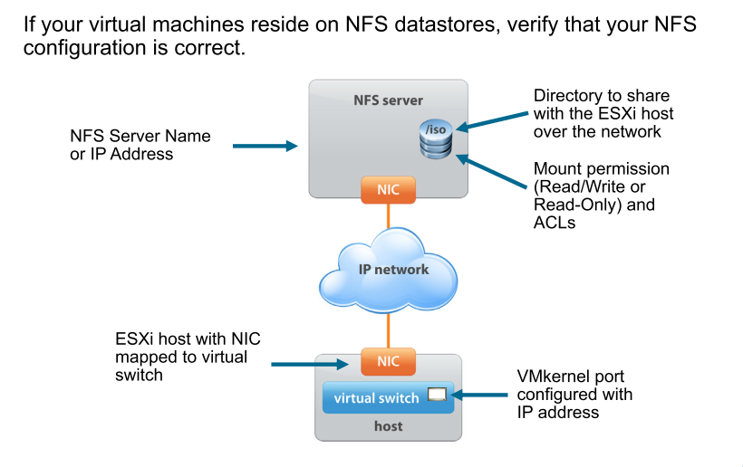
Possible Cause: NFS Misconfiguration

Slide 17
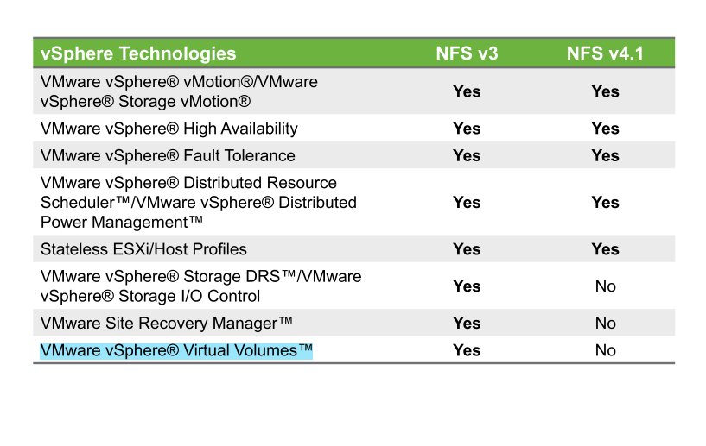
NFS Version Compatibility with Other vSphere Technologies

Slide 18
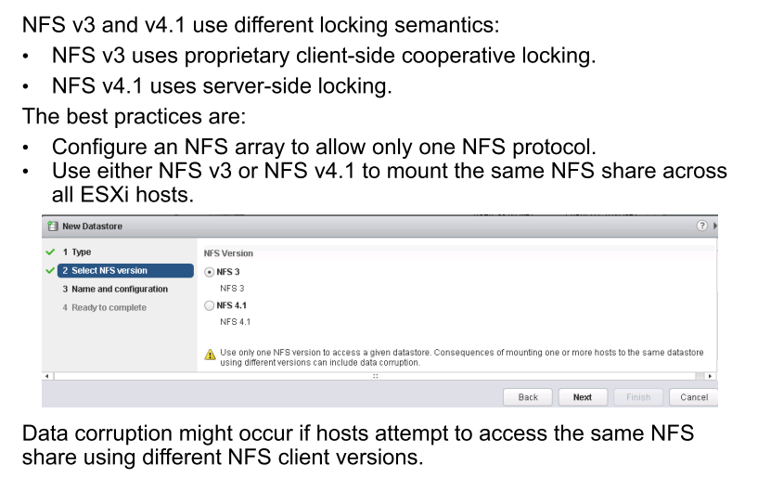
NFS Dual Stack Not Supported

Slide 19
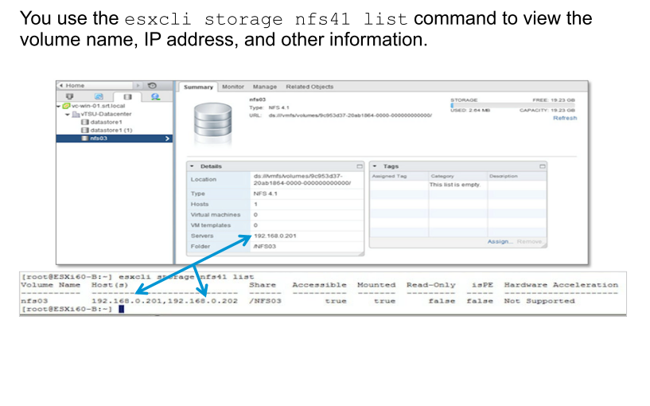
Viewing Session Information

Slide 20
Review of Learner Objectives
You should be able to meet the following objectives:
Discuss vSphere storage architecture
Identify possible causes of problems in various types of datastores
Analyze common storage connectivity and configuration problems and discuss possible causes
Solve storage connectivity problems, correct misconfigurations, and restore LUN visibility

Slide 21
Lesson 2: Multipathing

Slide 22
Learner Objectives
By the end of this lesson, you should be able to meet the following objectives:
Review multipathing
Identify common causes of missing paths, including PDL and APD conditions
Solve missing path problems between hosts and storage devices

Slide 23
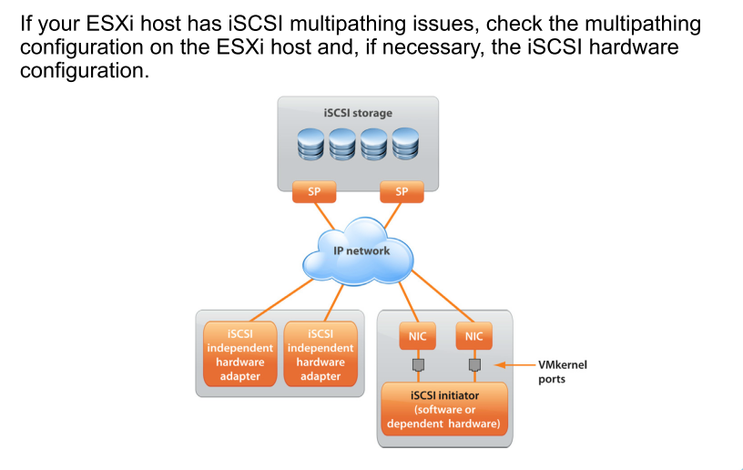
Review of iSCSI Multipathing

Slide 24
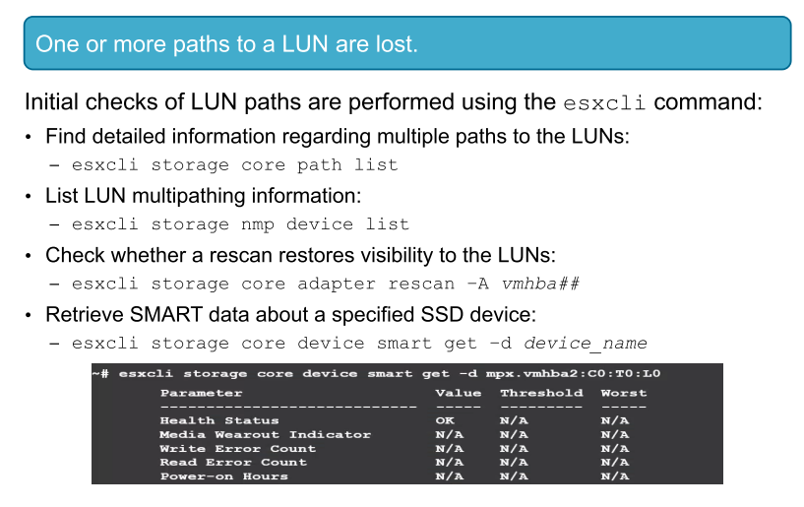
Storage Problem 2

Slide 25
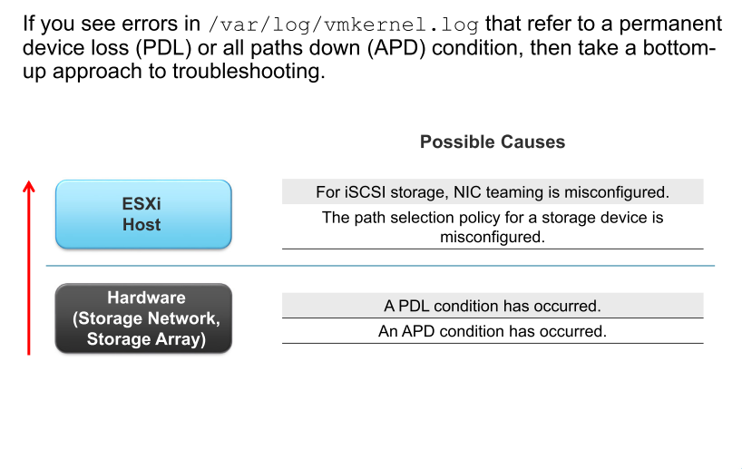
Identifying Possible Causes

Slide 26
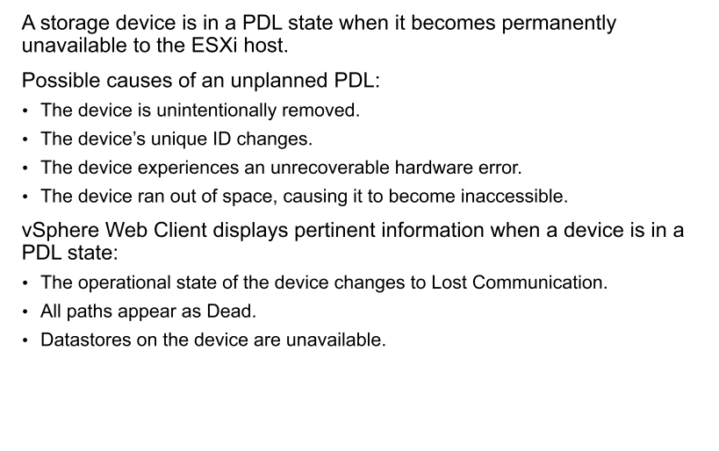
PDL Condition

Slide 27
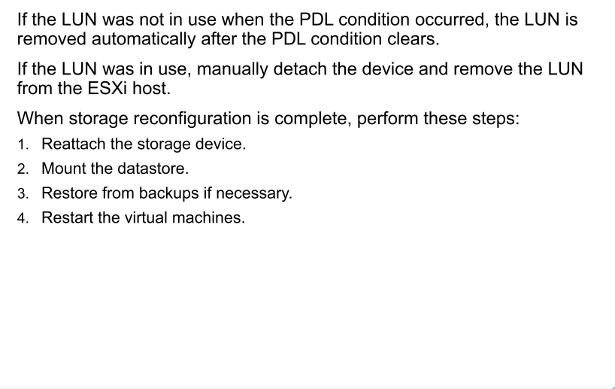
Recovering from an Unplanned PDL

Slide 28
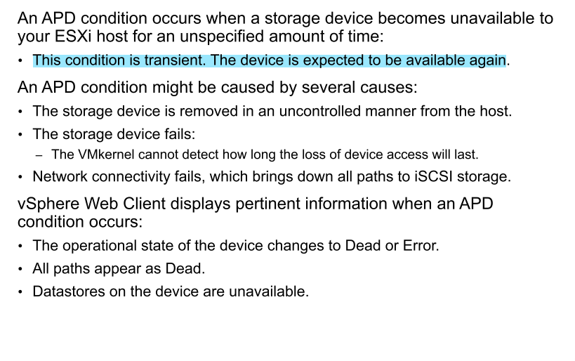
APD Condition

Slide 29
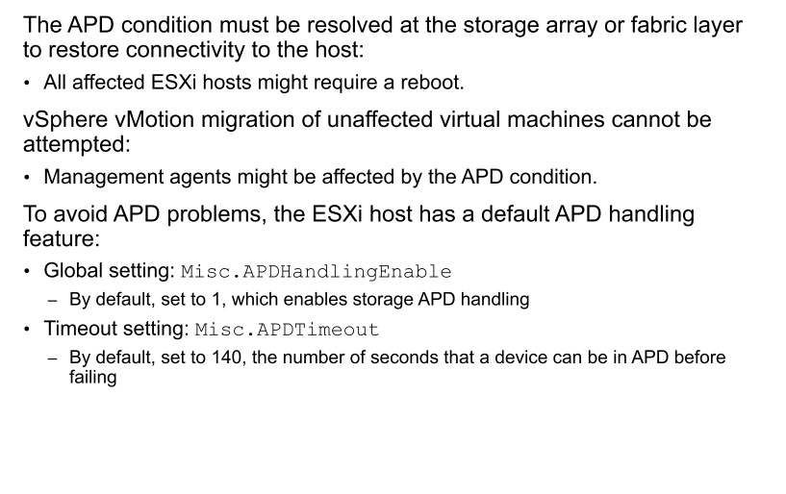
Recovering from an APD Condition

Slide 30
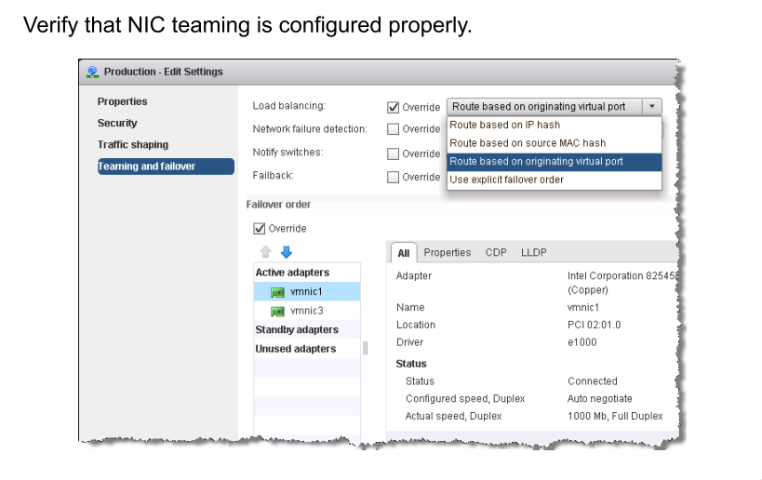
Possible Cause: NIC Teaming Misconfiguration

Slide 31
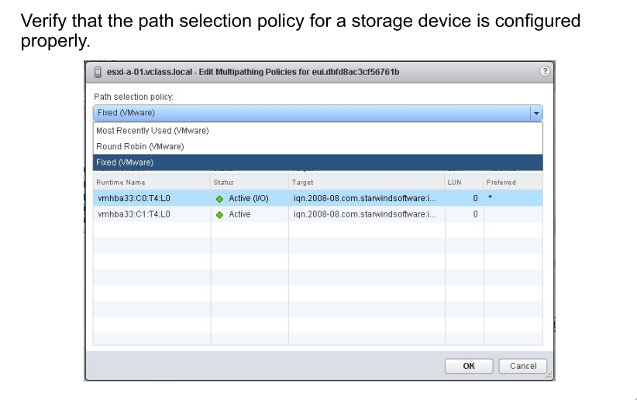
Possible Cause: Path Selection Policy Misconfiguration

Slide 32
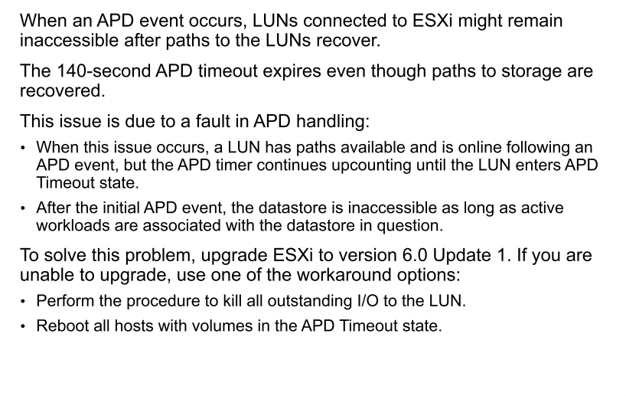
Possible Cause: Fault in APD Handling

Slide 33
Review of Learner Objectives
You should be able to meet the following objectives:
Review multipathing
Identify common causes of missing paths, including PDL and APD conditions
Solve missing path problems between hosts and storage devices

Slide 34
Lesson 3: Virtual SAN

Slide 35
Learner Objectives
By the end of this lesson, you should be able to meet the following objectives:
Become familiar with the various types of tools that are available to troubleshoot VMware Virtual SAN
Use the appropriate tools to identify, analyze, and quickly resolve common configuration problems related to Virtual SAN

Slide 36
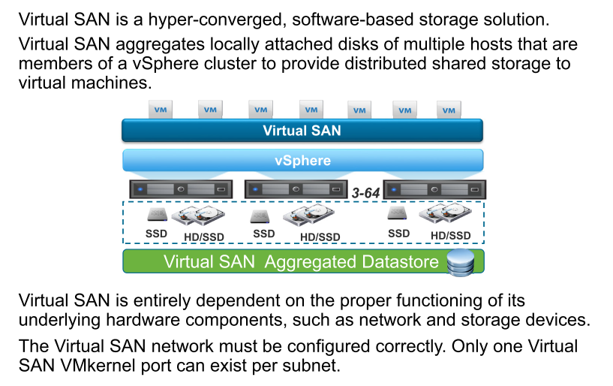
Review of Virtual SAN

Slide 37
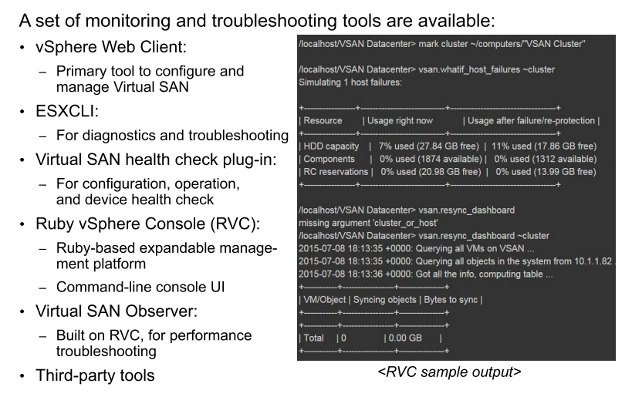
Virtual SAN Troubleshooting Tools

Slide 38
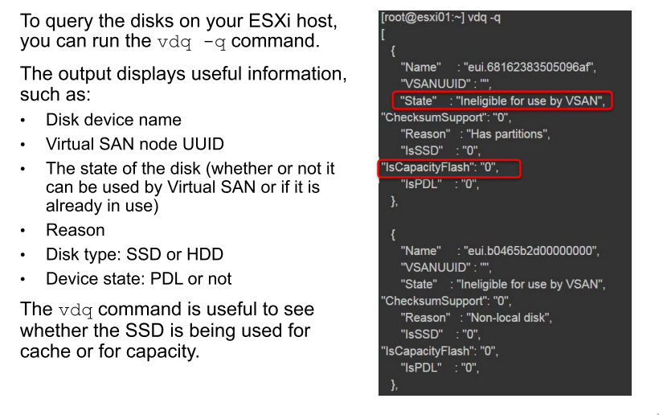
Virtual SAN Disk Query

Slide 39
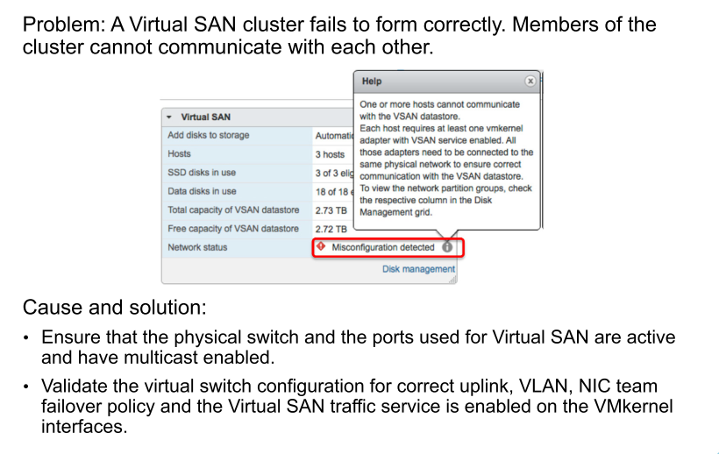
Virtual SAN Problem 1

Slide 40
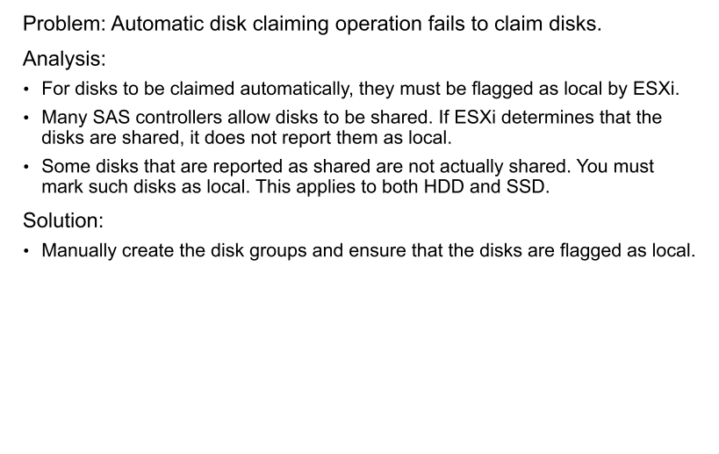
Virtual SAN Problem 2

Slide 41
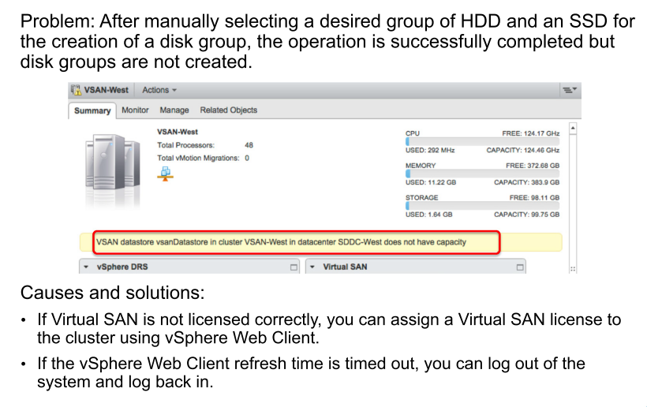
Virtual SAN Problem 3

Slide 42
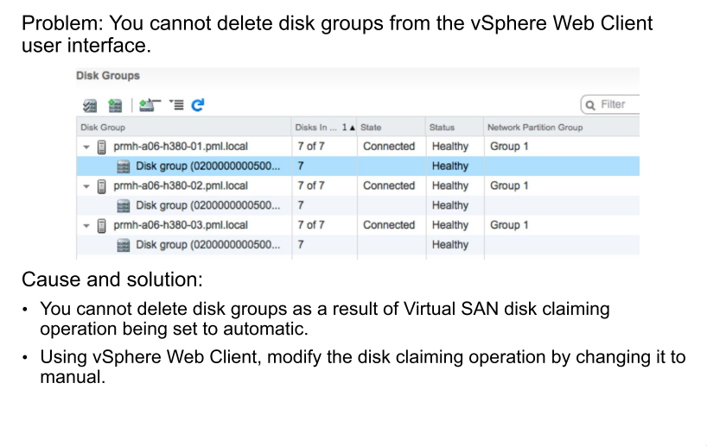
Virtual SAN Problem 4

Slide 43
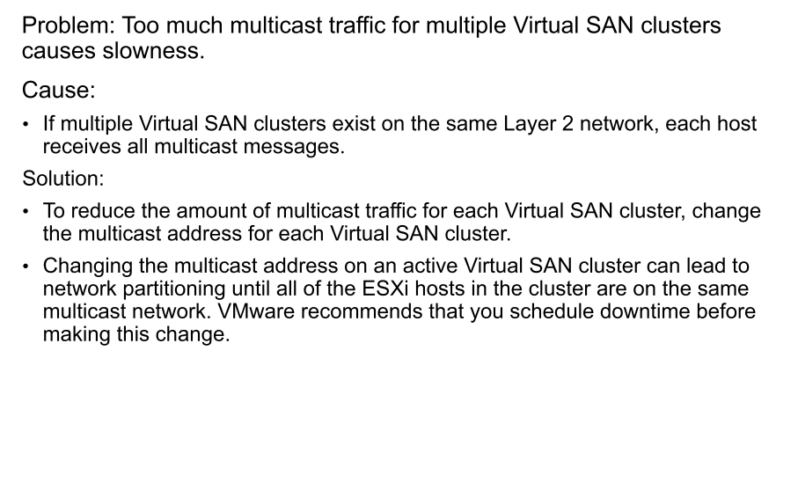
VSAN Problem 5

Slide 44
Review of Learner Objectives
You should be able to meet the following objectives:
Become familiar with the various types of tools that are available to troubleshoot Virtual SAN
Use the appropriate tools to identify, analyze, and quickly resolve common configuration problems related to Virtual SAN

